Slide 1
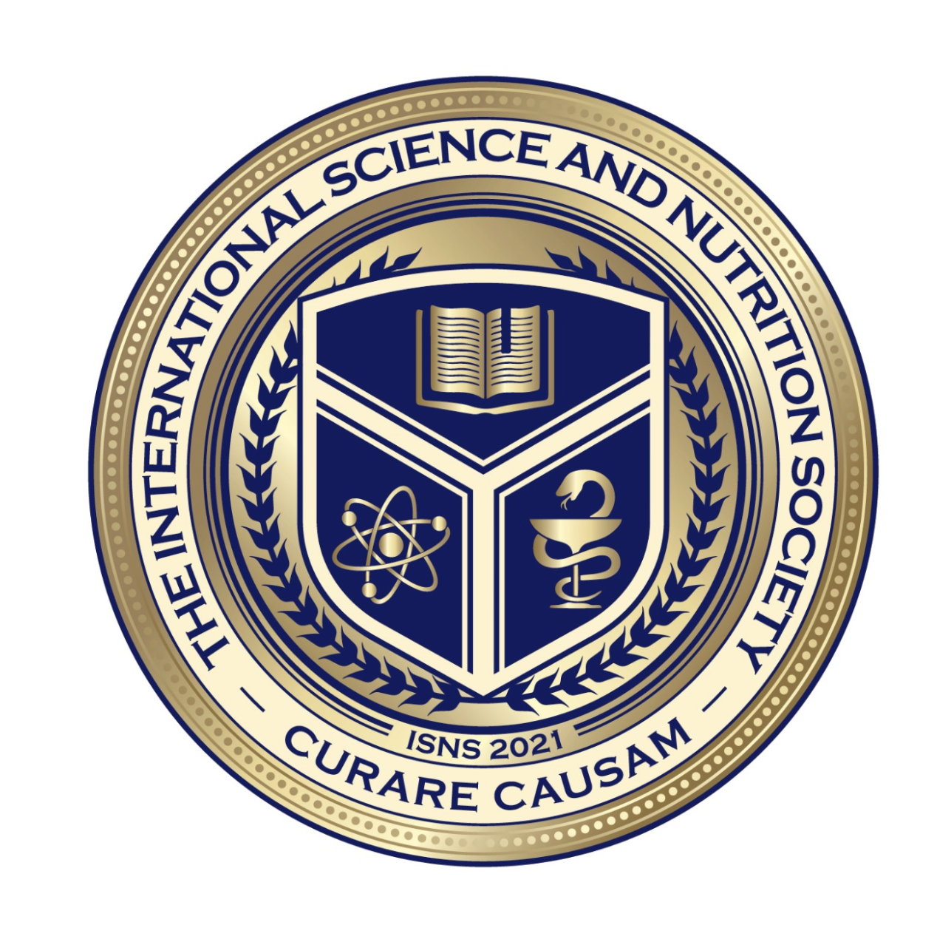
Science with Dr. Christina Rahm We will get started shortly.

Slide 2
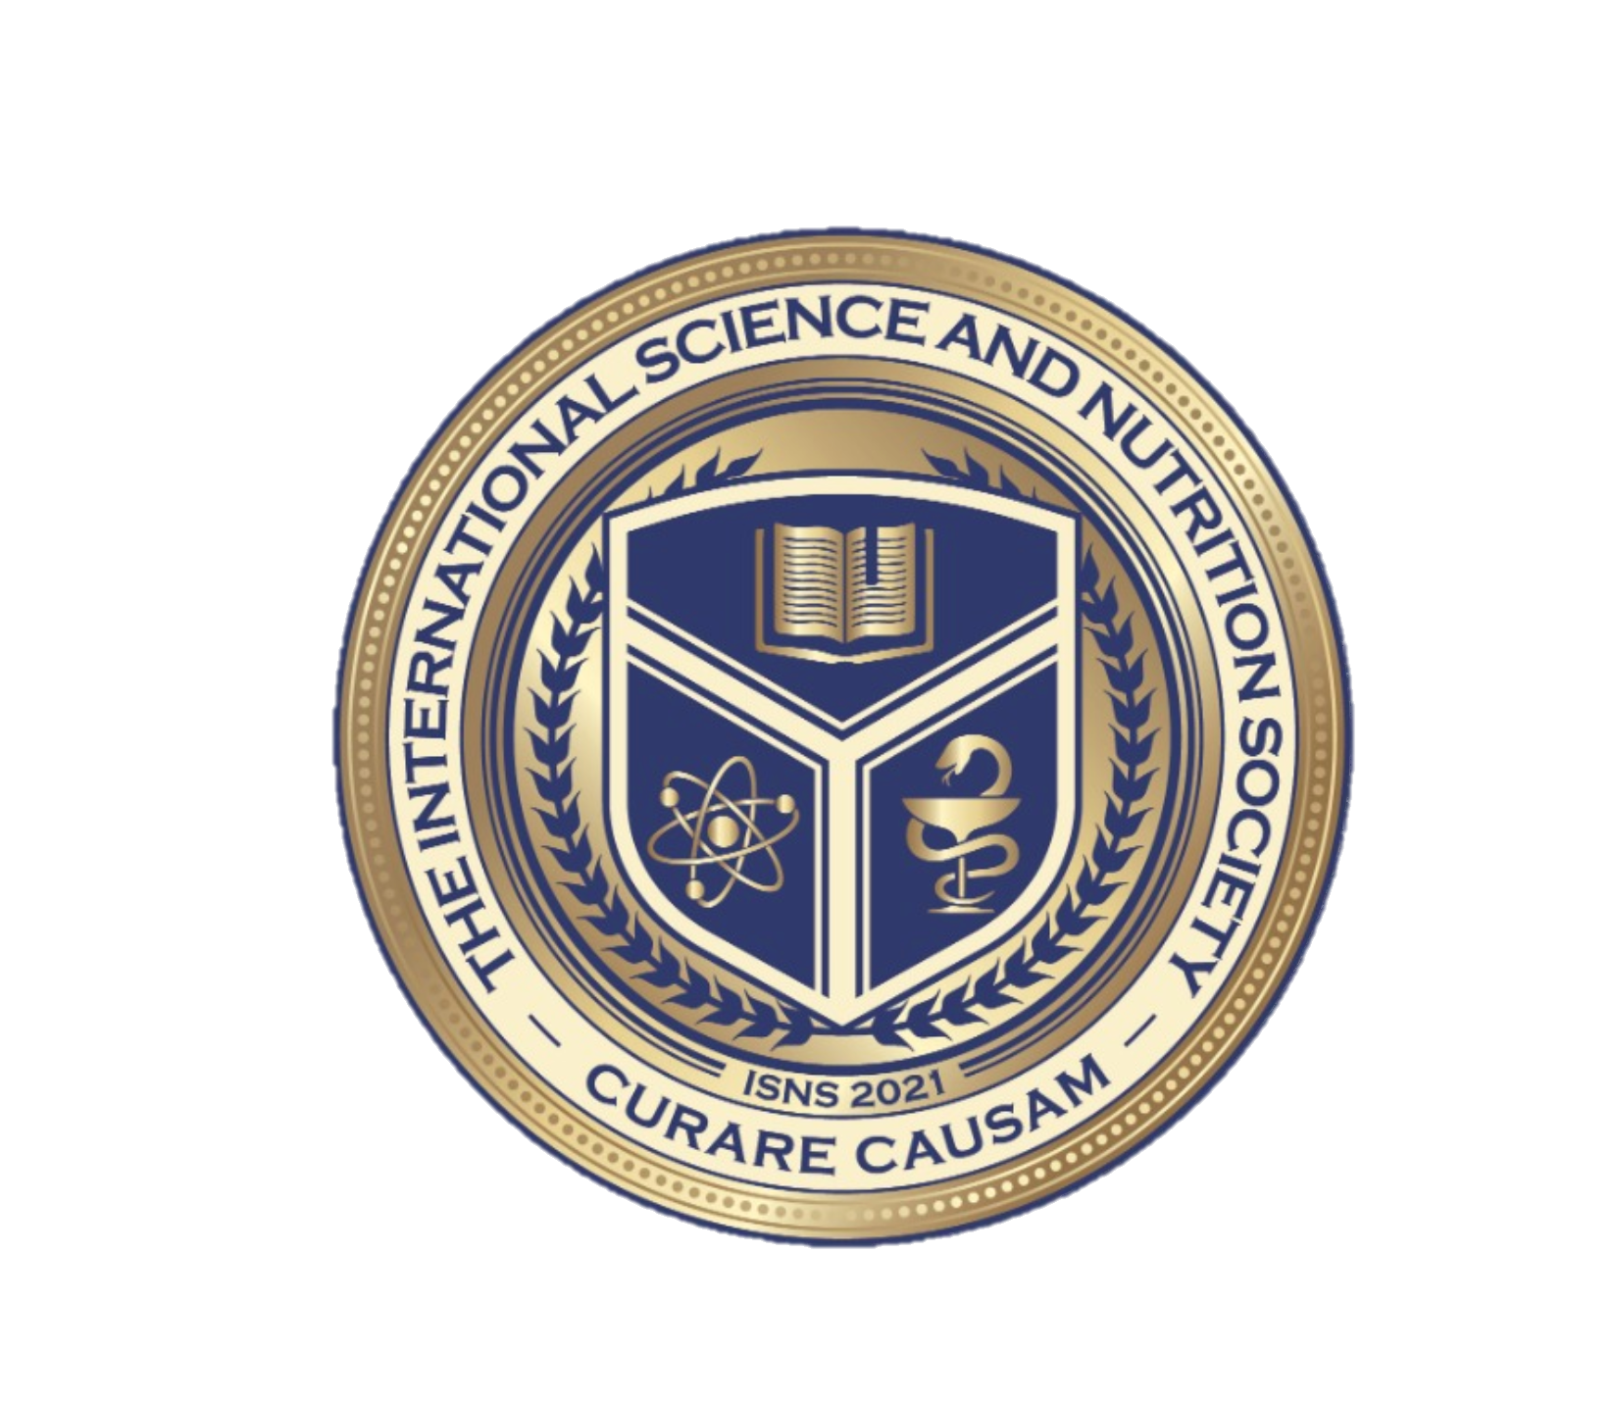
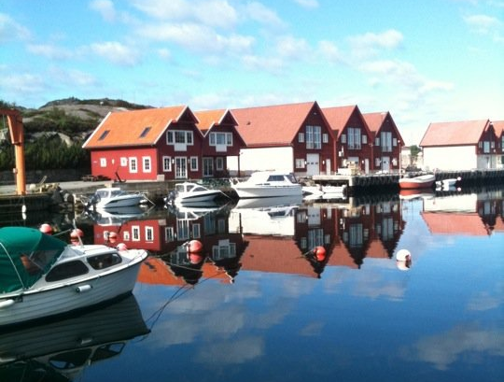
Dr. Dori Naerbo, Ph.D.
Notes:
Good morning, good afternoon, good evening…wherever you are in the world this is Dr. Dori Naerbo and I am your host on today’s call. For those of you who do not know me…I am a clinical researcher and author of several books.

Slide 3
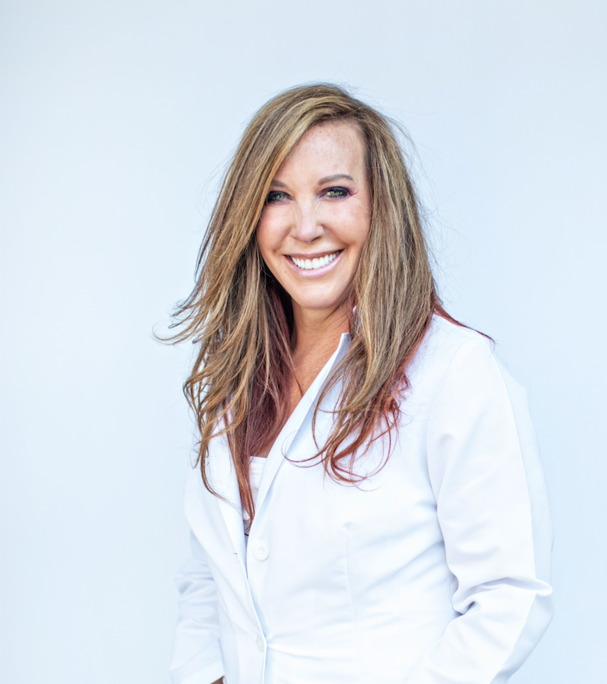
Dr. Christina Rahm CEO & Chief Science Officer

Slide 4
OVERVIEW OF ISNS

Slide 5
MEDICAL DISCLAIMER
THE INTERNATIONAL SCIENCE AND NUTRITION SOCIETY DOES NOT OFFER PERSONAL HEALTH OR MEDICAL ADVICE. IF YOUR FACING A MEDICAL EMERGENCY, CALL YOUR LOCAL EMERGENCY SERVICES IMMEDIATELY, OR VISIT THE NEAREST EMERGENCY ROOM OR URGENT CARE CENTER. YOU SHOULD CONSULT YOUR CARE PROVIDER BEFORE STARTING ANY NUTRITION, DIET, EXERCISE, FITNESS, MEDICAL,OR WELLNESS PROGRAM.
The content, developed through collaboration with licensed medical professionals, clinical researchers, scientists, and external contributors, including text, graphics, images, and other material contained on the website, apps, newsletter, and products (“Content”), is general in nature and for informational purposes only and does not constitute medical advice; the Content is not intended to be a substitute for professional medical advice, diagnosis, or treatment. Always consult your doctor or other qualified healthcare professionals with any questions you may have regarding a medical condition., over-the-counter drug, vitamin, supplement, or herbal alternative. ISNS makes no guarantees about the efficacy or safety of products or treatments described on ISNS content. Health conditions and drug information contained are subject to change and are not intended to cover all possible uses, directions, precautions, warnings, drug interactions, allergic reactions, or adverse affects. ISNS does not recommend or endorse any specific test, clinician care provider, product, procedure, opinion, service, or other information that may be mentioned in ISNS website, apps, and content.

Slide 6
What is ISNS?
The International Science Nutrition Society is a unique and innovative concept to acquire and share expertise in the field of science and nutrition, in its fullest sense of the word, emotional, mental, and spiritual nourishment.
ISNS was established on the principle that the science behind nutrition is often regulated to addressing problems without solving the root of the cause.

Slide 7
MEMBERSHIP BENEFITS
ISNS provides its members with the latest in research publications, abstracts, journals, posters, case studies, and white papers in the field of science and nutrition.
ISNS also provides opportunities for research and grants with an extensive library of multidisciplinary resources, including natural ingredients, minerals, vitamins, and seeds that are the basis of a natural and nutritional-rich lifestyle.

Slide 8
Membership Levels
Membership is open to anyone with an interest in the integrative sciences for humankind and the planet.
1-Basic
1 Monthly Newsletter
1 ISNS General Monthly Zoom
5% Discount off any book
5% Special Discount 1x per year
$9.95 per month
2-Associate
1 Monthly Newsletter
1 Monthly General Zoom
10% off books and some ISNS
Access to ISNS Library
$12.95 per month
3-Professional
1 Monthly Newsletter
1 Monthly Associate Zoom
White Papers
15% off books
10% off Annual Professional Meeting
1 on 1 with a member of the Science Advisory Board
Private Meeting or Zoom at the annual meeting
$24.95 per month

Slide 9
ISNS Complementary and Integrative Medicine
1. Alternative Medical Systems
2. Mind-body interventions
3. Biologically based treatments
4. Manipulative and body-based methods
5. Energy therapies

Slide 11
Let’s Walk Through The Case Study Form

Slide 12
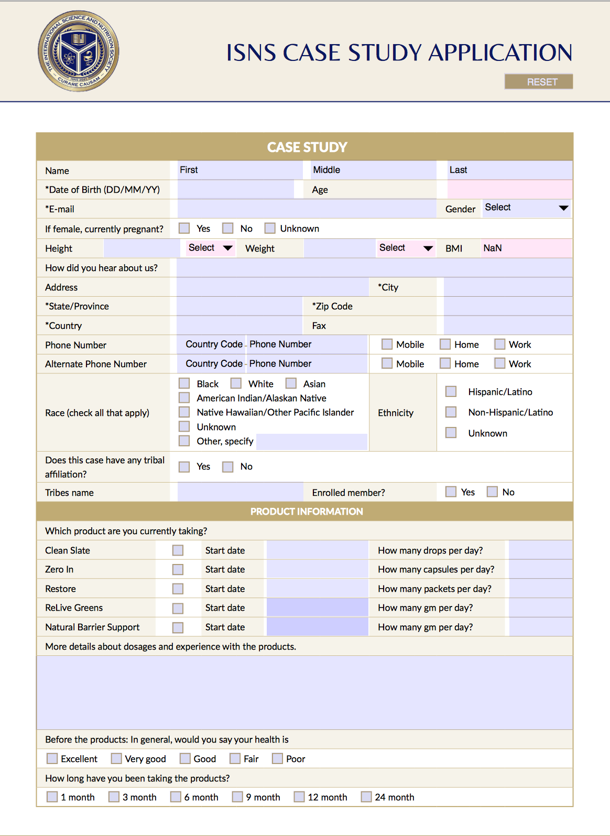
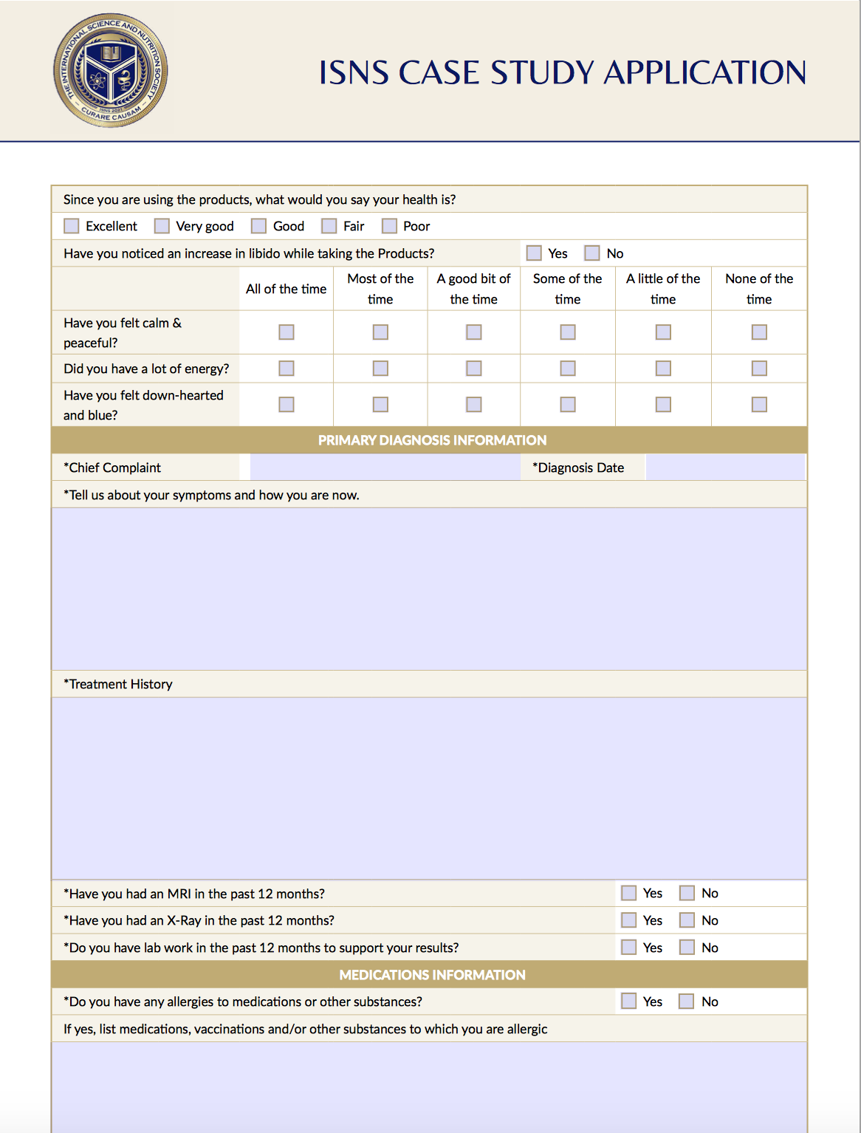

Slide 13
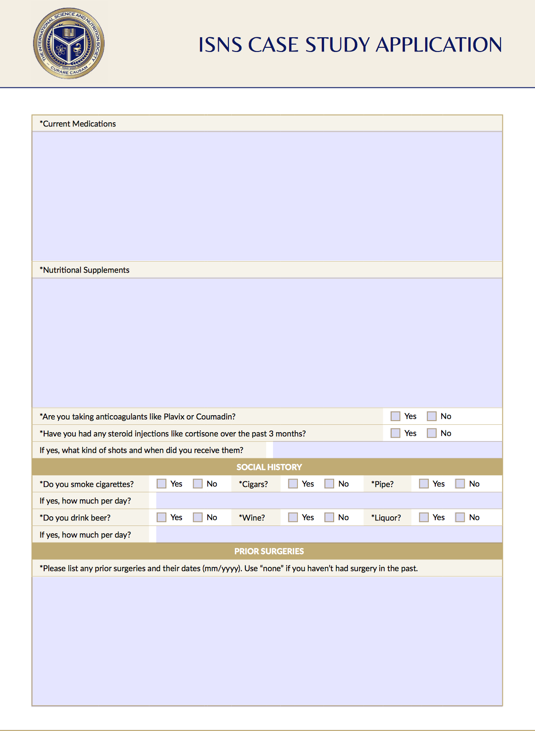
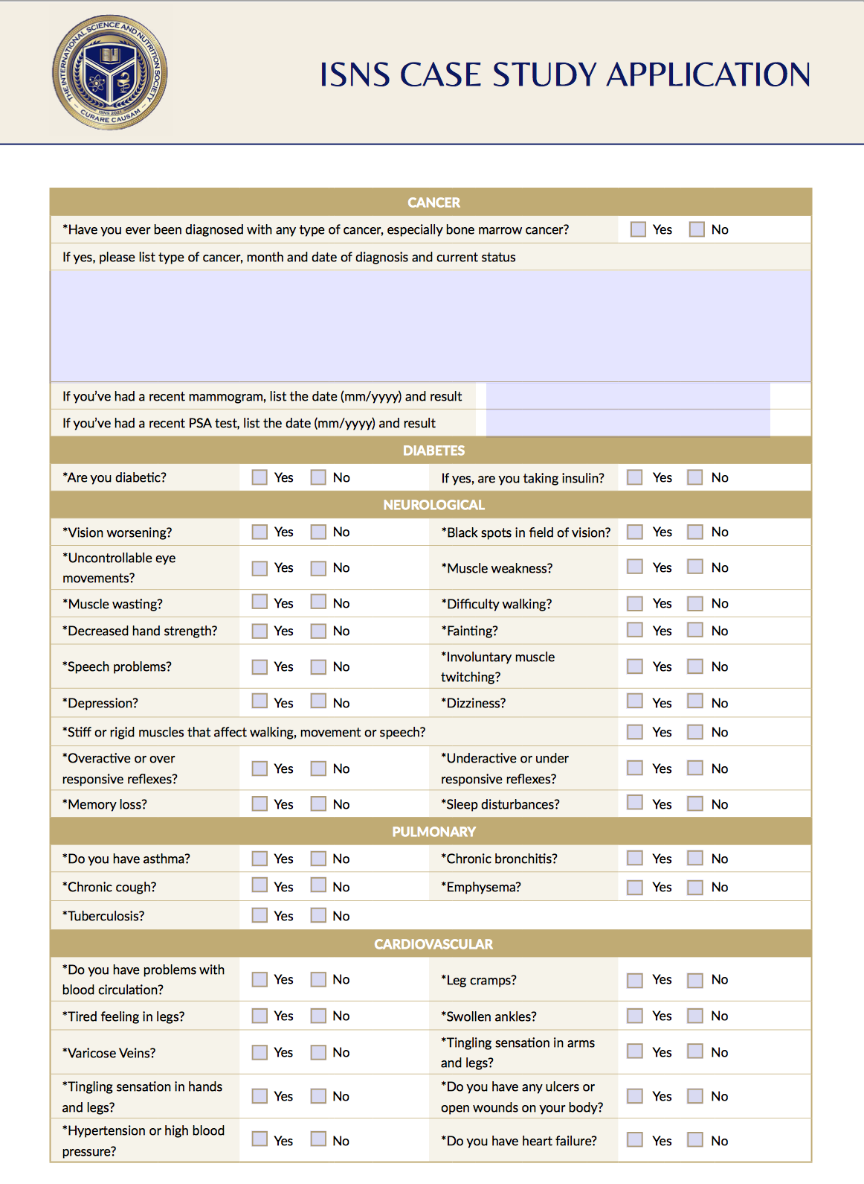

Slide 14
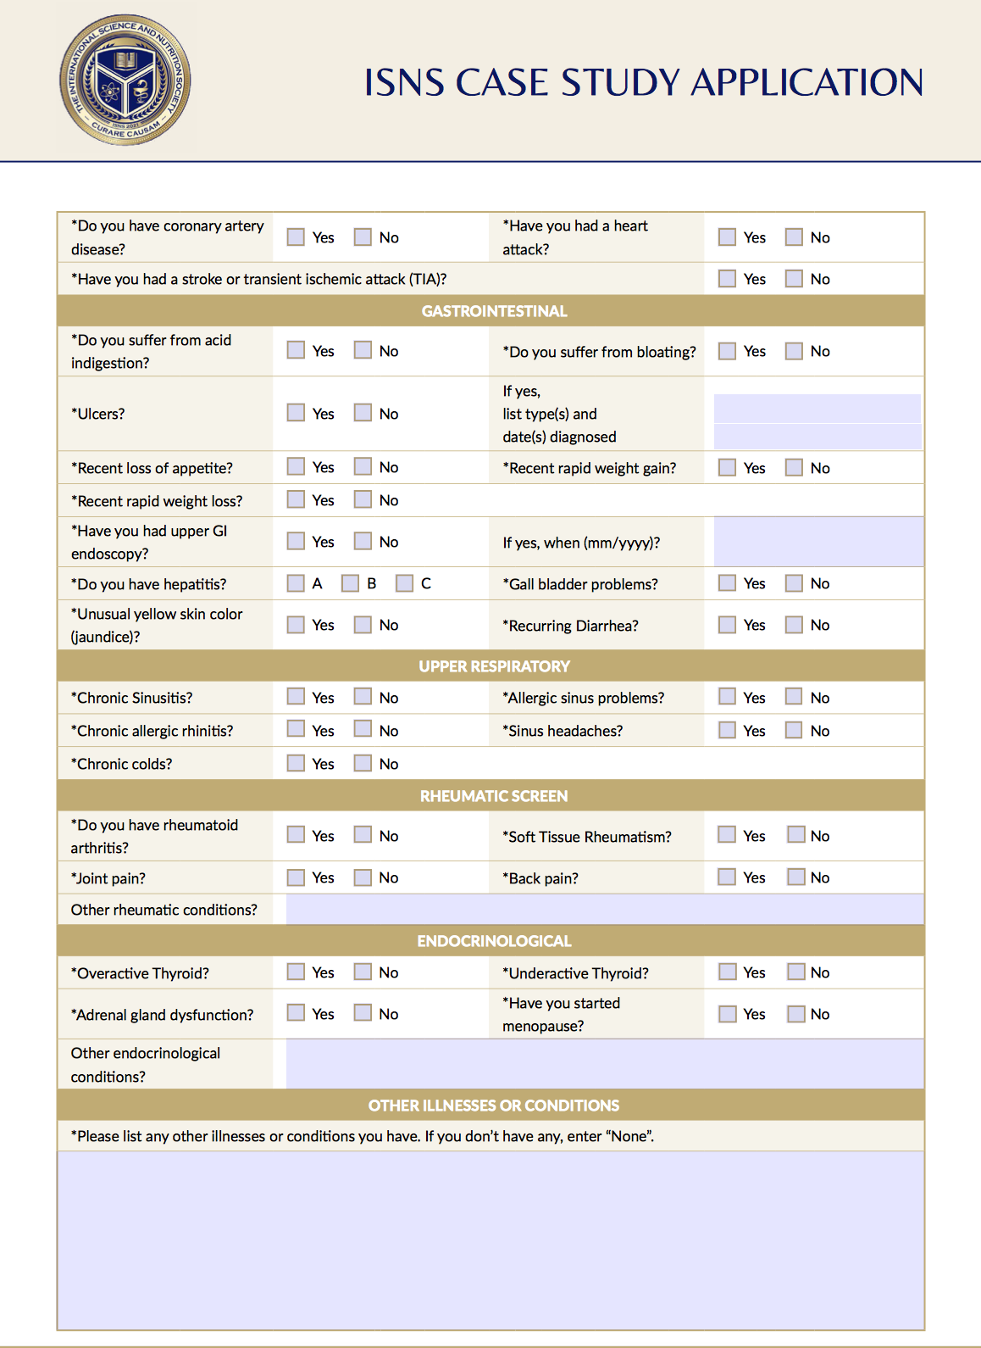

Slide 15
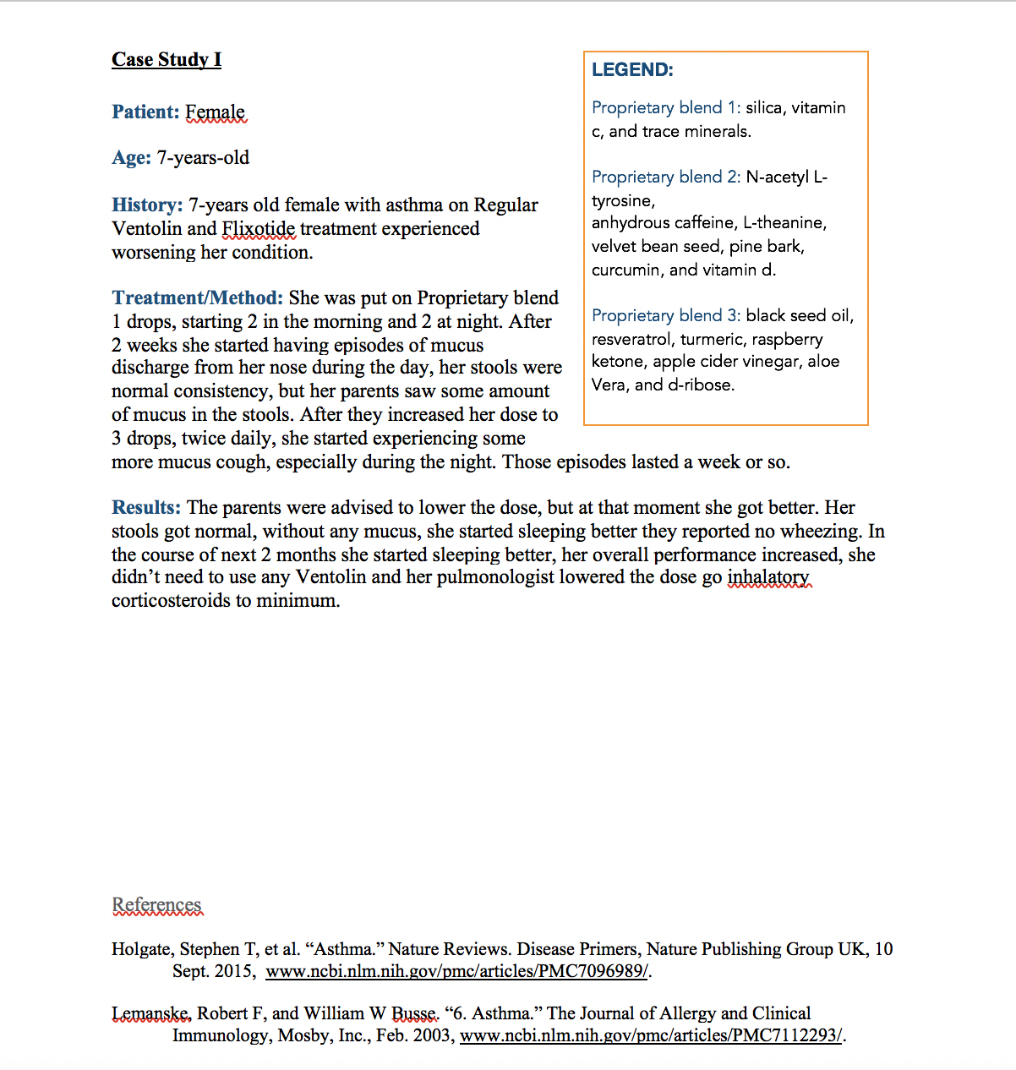
Finished Case Study

Slide 16
THANK YOU FOR JOINING US TODAY
Go Visit https://sciencenutritionsociety.com to sign up now!

